Slide 1


Slide 2



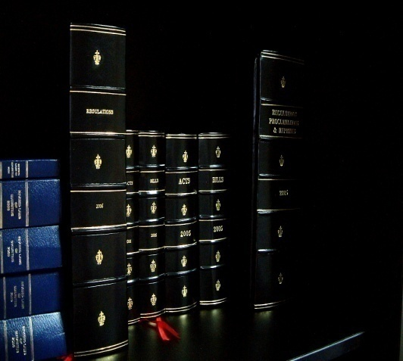

Promoting Financial Literacy and Young Talent Competition (YTC) 2016
Briefing session
Presented by: Amit Ramjeet
Policy – Financial Literacy, Consumer Awareness and Complaints Handling
Date: 10 May 2016

Slide 3

Where it all started …
The Promoting Financial Literacy & Young Talent Competition (YTC)
The Financial Services Commission (FSC) is mandated under Section 6 (f) of the FSA 2007 to:
“promote public understanding of the financial system including awareness of the benefits and risks associated with different kinds of Investment”
The Promoting Financial Literacy & Young Talent Competition (YTC) was launched in the context of the FSC’s 10th Anniversary in 2011.
Fifth Edition in 2016. Introduction of Quiz Competition for Form IV and V students since 2014. Broadcast of quiz final on TV for 2 years running.

Slide 4
Objectives & Benefits of YTC
Practise financial planning, inculcate the habit of investing and saving for the future. Facilitate the selection of suitable investment projects to match one’s objectives and priorities
Promote financial literacy and a better understanding of the financial services sector among students in Mauritius
To choose a field of professional education and explore future employment opportunities. Understand risk-return matrix to make informed investment decisions

Slide 5
YTC – At a glance
YTC 2012
Theme: Sustaining the Development of the Financial Services in Mauritius
Number of entries received: 55 Secondary and 10 tertiary
Winners:
Droopnath Ramphul State College (Secondary)
Brains Quest – UoM (Tertiary)
YTC 2013
Theme: Mauritius Insurance Industry in Year 2020
Number of entries received: 72 Secondary and 5 tertiary
Winners:
Droopnath Ramphul State College (Project Work Secondary),
Hindu Girls College (Creative Work Secondary)
The Black Swans – UoM (Tertiary)
YTC 2014
Theme: The Mauritius International Financial Centre (IFC)
Number of entries received: 90 teams for Quiz Competition and 141 teams for Essay Competition
Winners:
Droopnath Ramphul State College for Quiz Competition
Loreto College Rose-Hill for Essay Competition
YTC 2015
Theme: Financial Inclusion contributes to Economic Growth
Number of entries received: 138 teams for Quiz Competition and 200 teams for Essay Competition
Winners:
College du St Esprit for Quiz Competition
MGI for Essay Competition

Slide 6
Young Talent Competition 2016

Slide 7
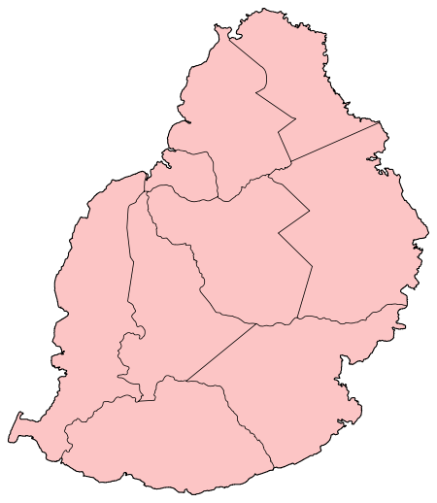
YTC 2016 - Entries received
280 teams registered
54 schools
Category 1 (Quiz): 125 teams
Category 2 (Essay): 155 teams
All districts of Mauritius covered

Slide 8
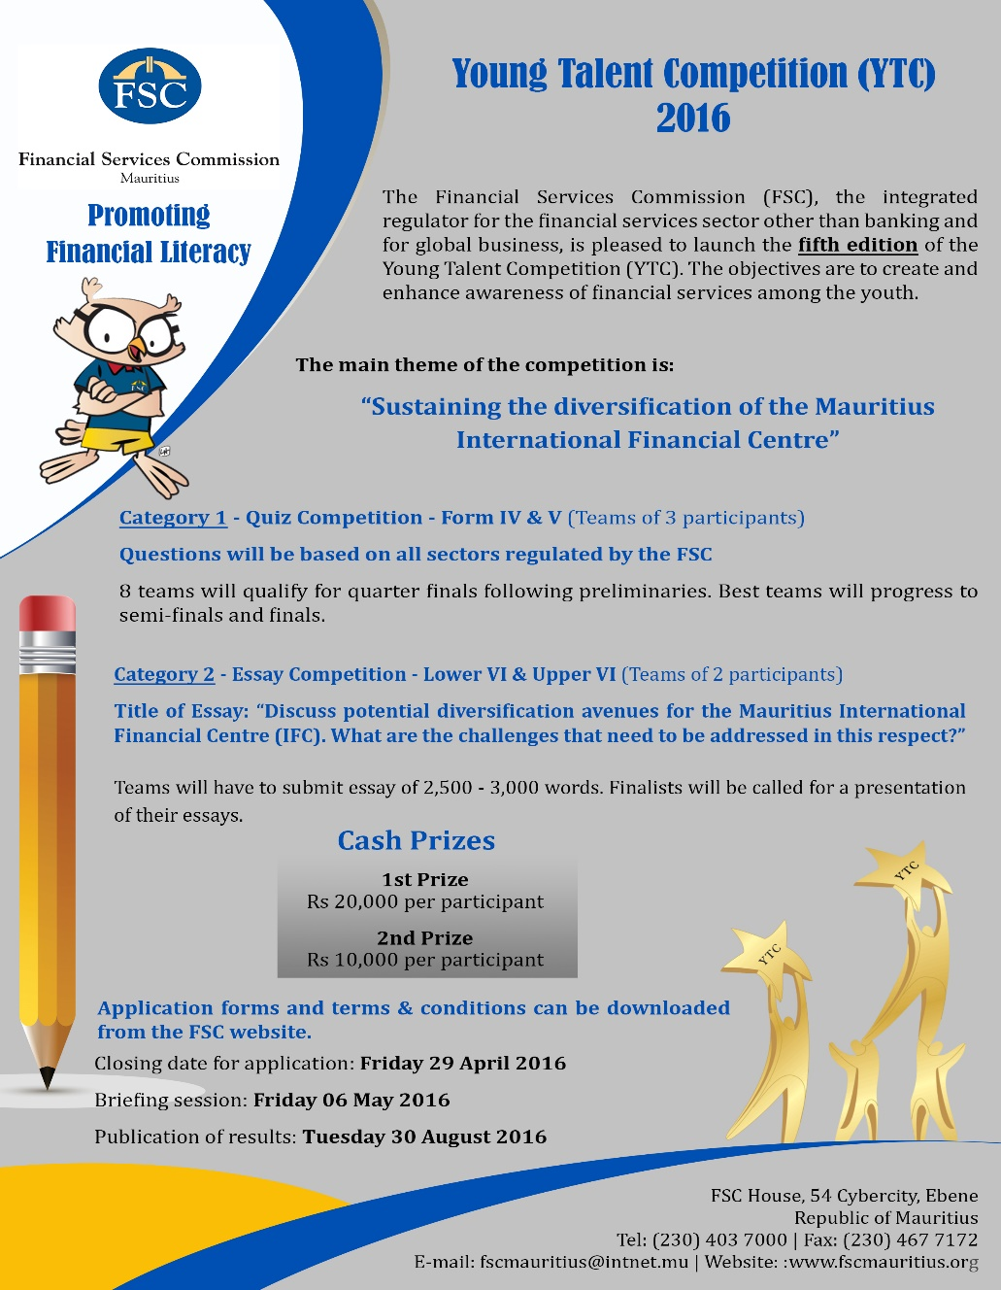
Poster Sent to Secondary Schools
Theme & Dissemination
Theme: Sustaining the diversification of the Mauritius International Financial Centre
Title of Essay: ‘Discuss potential diversification avenues for the Mauritius International Financial Centre (IFC). What are the challenges that need to be addressed in this respect?.’

Slide 9
Conduct of YTC 2016
Eligibility
Category 1 – Quiz Competition
Category 2 – Essay Competition
Form IV & Form V students of any registered secondary schools in Mauritius (Team of 3 participants);
Lower Six and Upper Six students of any registered secondary schools of Mauritius (Team of 2 participants)
Requirements for each category
Category 1
Questions based on all sectors regulated by the FSC
Category 2
Teams to submit an essay of 2,500 – 3,000 words
Finalist teams will be called for a presentation of their essays at the FSC House in front of a jury panel
Preliminary round followed by elimination rounds

Slide 10
Important dates for YTC 2016
General
Briefing session | Tuesday 10 May 2016
Award Ceremony | Wednesday 24 August 2016
Quiz Competition
Preliminary Round | Tuesday 17 May 2016 – Selection of 32 best teams
2nd Round | Friday 01 June 2016 – Selection of 8 best teams
Quarter finals | Wednesday 08 June 2016 – Selection of 4 best teams
Semi-finals | Wednesday 15 June 2016 – Selection of 2 best teams
Final | Wednesday 22 June 2016
Essay Competition
Submission of Essays | Friday 17 June 2016
Presentation by finalists | Thursday 30 June 2016

Slide 11
Help Desk /Other Requirements
Complete all Forms where applicable and leave at Help Desk
Names and contact number/s of Responsible educators should be registered
Questions can be addressed to officers at the Help Desk
Teams to bring along 2B Pencils for Quiz Preliminary on 17 May 2016

Slide 12
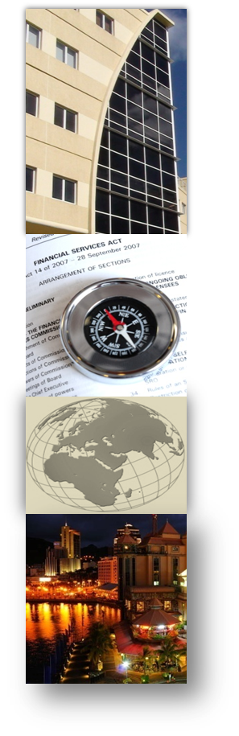
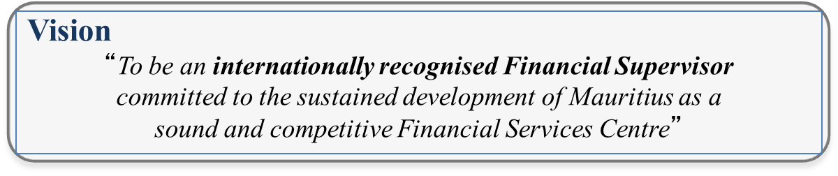
THANK YOU
FOR YOUR KIND ATTENTION

Slide 13

FSC House
54 Ebene Cybercity
Mauritius
Tel: (230) 403 7000
Fax: (230) 467 7172
Email: fscmauritius@intnet.mu
www.fscmauritius.org
13
Notes:
Global Banking: Paradigm Shift - Strategies to Build Successful Wealth Management Business
Financial Services Commission
13

Slide 15
“Sustaining the diversification of the Mauritius IFC.” Discuss potential diversification avenues for the Mauritius IFC. What are the challenges that need to be addressed in this respect?
        Presented by: Gamal Ballam
        10 May 2016

Slide 16

AGENDA
Introduction
Definitions
Some Diversified IFCs
Mauritius – Some Figures
Why Diversification?
Challenges
Our Expectations
Conclusion

Slide 17

INTRODUCTION

Slide 18
Definitions
IFCs play a significant role in bringing together users of capital and the providers of capital who happen to be in different locations. International as well as domestic market accessibility is thus important for any location to be an IFC;
Market accessibility, amongst others, consists of volume and value of trading in equities and bonds, and the clustering effect of having many firms involved in the financial services sector together in one centre.

Slide 19
DIVERSIFIED IFCs

Slide 20
Examples of Diversified IFCs (1)
London and New York are the top two IFCs in the world, followed by Singapore, Hong Kong and Tokyo;
The top financial centres of the world are all well developed, sophisticated and cosmopolitan cities in their own right;
London has the best financial sector development in the world;
Tokyo, Hong Kong and Singapore have excellent access to international financial markets;

Slide 21
Examples of Diversified IFCs (2)
Hong Kong is a highly diversified financial centre with its strengths in equities and banks;
Singapore is very strong in foreign exchange markets and OTC derivatives;
Tokyo has the largest stock exchange, foreign exchange and derivatives turnovers in the Asia-Pacific region;

Slide 22
SOME FIGURES FOR MAURITIUS

Slide 23
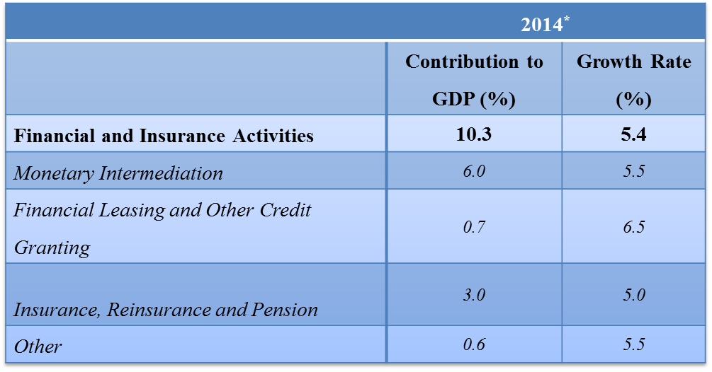
Some Figures – Growth Contribution
Source: Statistics Mauritius - National Accounts - December 2014 issue
Note: * Provisional

Slide 24
Mauritius IFC
Ranked 73rd in March 2016;
An excellent banking sector;
One equity market (Stock Exchange of Mauritius) and one Derivative market (Bourse Africa);
A vibrant Insurance sector and a developing Private Pensions sector;
A progressing Funds industry.

Slide 25
WHY DIVERSIFICATION?

Slide 26
Why Diversification?
To fuel further development
To attract a new type of investors
To create jobs
To sustain growth in the economy
New product offerings

Slide 27
CHALLENGES

Slide 28
Challenges
Availability of specialised professionals
Knowledge when it comes to future development
Technological expertise and availability
Marketability of the jurisdiction

Slide 29
OUR EXPECTATIONS

Slide 30
Performance Criteria
Understanding: As appropriate to task, the response demonstrates secure understanding of key elements, central concerns and significant details of the Topic. Technical accuracy is present as well as innovative ideas and creativity;
Analysis: The response explains accurately and in detail ways the aspects of the Topic and the way it is discussed (Assessment of existing literature, concepts, provide statistics);
Expression: Structure, style and language, including use of appropriate critical terminology, are deployed to communicate; spelling, grammar and punctuation are sufficiently accurate.

Slide 31
Technical Accuracy
An essay which does not satisfy the requirement for “sufficient” technical accuracy cannot pass.
The definition of “sufficiently accurate” is: Few errors will be present. The Topic question is well developed with clear indications on how to go about. Technicalities are well argued and presented (pros and cons provided where relevant). Statistics are provided to substantiate any argument and literature on the topic clearly discussed.

Slide 32
CONCLUSION

Slide 33
Overall
Discuss the current Mauritius IFC;
Discuss possible avenues for diversification;
Challenges that will have to be overcome in order to make proposals a reality ;
Facts and Figures to substantiate any propositions.

Slide 34

Any Questions

Slide 35
THANK YOU
FOR YOUR KIND ATTENTION

Slide 36
54 Ebene Cybercity
Mauritius
Tel: (230) 403 7000
Fax: (230) 467 7172
Email: fscmauritius@intnet.mu
www.fscmauritius.org
36
Notes:
Global Banking: Paradigm Shift - Strategies to Build Successful Wealth Management Business
Financial Services Commission
36

